Slide 1
Trigonometry bouncing_ball.py
Computer Science and Software Engineering
© 2014 Project Lead The Way, Inc.

Slide 2
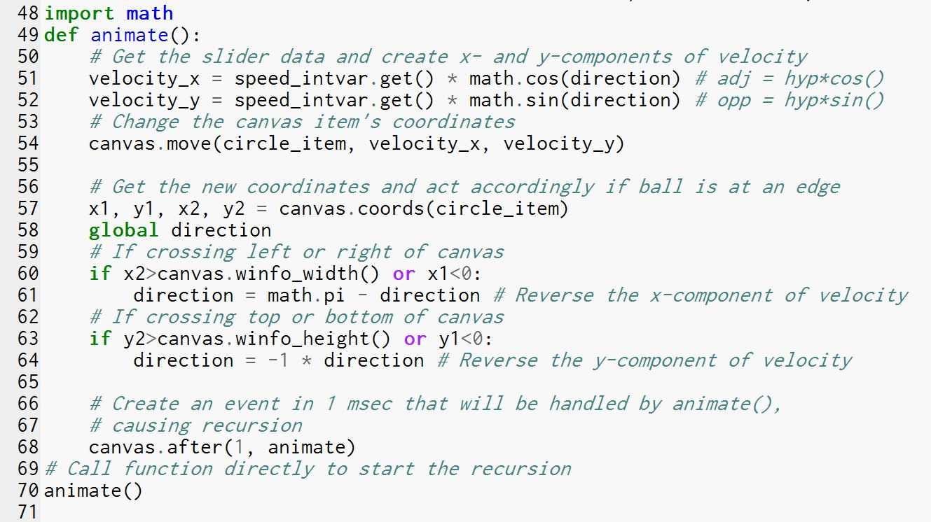
Animation:
Resolving a Vector into Components
Notes:
Knowing a little about trig will help you in two ways in this problem. First, it will help figure out how much an object’s x and y coordinates change when the object is moving at an angle. Notice the sine and cosine functions being used in lines 51 and 52.

Slide 3
Animation:
Using Radians
Notes:
The second place we use trig in the starter code is in lines 61 and 64. It’s not really trig per se, but we are using angles measured in radians and thinking about angles in “standard position”. This is typically taught in math classes alongside trig. The pi in line 61 is actually an angle: it is 180 degrees. The negative 1 in line 64 changes the angle too, because angles in “standard position” can be negative!

Slide 4
Vectors
Vectors = magnitude and direction
Scalar vs. Vector
Speed vs. Velocity
c
Notes:
The animated, moving ball has a speed and a direction. Together, those are called “velocity” in physics. Velocity is a *vector* because it has a direction, while speed is only a *scalar*. A scalar is just a magnitude, an amount, while a vector has both magnitude and direction. In this picture the ball is moving up and to the right on the screen. Its velocity is represented by an arrow, labeled c.

Slide 5
Vector Components
Resolving a vector into components
c
b
θ
a
Notes:
It is often useful to separate these two parts of the vector. This is called resolving a vector into components. The vector has a rightward component, labeled “a” here. The vector also has an upward component, labeled “b” here. Trig allows you to determine how long a and b are if you know c and the angle theta.
Vector a + vector b = vector c.
Because vectors have BOTH direction and magnitude, you have to take the direction into account when you add them together. Notice that following vector a to the right and then following vector b up moves the ball to the same place as just following c.
Vector “a” is called the x-component of vector c. Vector b is the y-component of vector c. How do we find out how much the ball moves in just the x direction? Or just the y direction? We use right triangle trig.

Slide 6
Right Triangle Trigonometry
Hypotenuse and two legs
hypotenuse
opposite
θ
adjacent
Notes:
Looking at this right triangle, we know that the hypotenuse is the longest side, the one that is not part of the right angle.
There are two legs to the right triangle, though. We pick one of the acute angles to work with. Here we’ve labeled one angle, measured theta. That’s a Greek letter frequently used to represent angle measurements.
The triangle leg that forms that angle theta is the adjacent leg. The opposite leg is across the triangle from theta.

Slide 7
Right Triangle Trigonometry
sine (sin), cosine (cos), and tangent (tan)
SOH-CAH-TOA
hypotenuse
opposite
θ
adjacent
Notes:
There are three primary trig functions: sine, cosine, and tangent, abbreviated with three letters as shown here. They are each a ratio of two side lengths. An acronym SOH-CAH-TOA is useful for remembering what these three ratios are.

Slide 8
Trigonometry Review
Right Triangle Trigonometry
Trigonometric Functions
sin θ = opp / hyp SOH
cos θ = adj / hyp CAH
tan θ = opp / adj TOA
Hypotenuse (hyp)
Opposite Side (opp)
θ
90°
Adjacent Side (adj)
Notes:
The sine of an angle is the ratio of the opposite side to the hypotenuse. SOH reminds us of that: sine is opposite over hypotenuse.

Slide 9
Applying the Right Triangle Trig
sin θ° = v_{y} / v
cos θ° = v_{x} / v
tan θ° = v_{y} / v_{x}
v_{y}= v sin θ°
v_{x}= v cos θ°
speed = v
y component = v_{y}
θ
90°
x component = v_{x}
Notes:
Applying this to the ball’s motion, we can figure out the x and y components of the velocity. Vx and vy will tell us how much the x and y coordinates of the ball change per unit of time (per millisecond in our code since after() is using 1 millisecond as its argument). The sin is opposite over hypotenuse. That’s vy over v.
To solve for vy, we multiply both sides by v.
Then we do the same thing with cosine. These two equations in blue solve our problem! They tell us how much the ball moves in the x and y directions when it is moving at an angle.

Slide 10
Animation:
Resolving a Vector into Components
v_{x} = v cos θ°
v_{y} = v sin θ°
Notes:
In line 51, speed_intvar.get() returns the speed of the ball from the Scale’s variable. That’s v in the equation below. We multiply by cosine of the angle to get the x component. The angle is the variable “direction”. So line 51 finds the x component of the ball’s motion, and line 54 change the x-coordinate by that amount. Now practice by explaining how line 52 and line 54 change the ball’s y coordinate.
So now you see how we used sin and cos. The sin() and cos() function from the math library require the angle to be measured in radians. This brings us to the second topic.

Slide 11
Standard Position for an Angle
Counter clockwise from the positive x axis
c
b
θ
a
Notes:
A vector points in a direction. If it points to the right, we call that 0 degrees. Straight up is 90 degrees. Left is 180 degrees. Down is 270 degrees. And 360 degrees is back to pointing to the right.

Slide 12
Standard Position for an Angle
Counter clockwise from the positive x axis
θ
c
Notes:
Another unit for measuring angles is the radian. It’s used more than the degree by mathematicians because it makes it makes it easier to find distances along curves.

Slide 13
Radians
0.5π
∼0.2π?
θ
π
c
0 or 2π
1.5π
Notes:
Pi radians is 180 degrees. You can practice with your teacher or a friend. One person calls out pi, 7pi, 6.5 pi, etc., and the other person points in the correct direction with their arm fully extended from their body. This works well as a whole class exercise.

Slide 14
Applying the Angle Measures
0.8π
0.2π
θ
π
Notes:
The ball shown here is bouncing off the left wall. The two directions are shown on the circle. These will always add up to 180 degrees, the same as pi radians. So whatever the ball’s angle is, we subtract the angle from pi to bounce off the left wall. Try a few angles to convince yourself that it also works on the right wall.

Slide 15
Applying the Angle Measures
1.1π
θ
π
−1.1π
Notes:
When the ball bounces off the bottom wall, the +/- sign of the angle just switches. Try a few angles to convince yourself that this also works for bouncing off the top.

Slide 16
What about wrapping?
Notes:
What happens to the direction of the ball when it wraps around the screen? What happens to its x coordinate? Its y coordinate?

Slide 17
Animation:
Using Radians
Notes:
Can you make sense of lines 61 through 64 now? Notice that math.pi is just a number from the math module: 3.1415…

